Slide 1
6.837 Linear Algebra Review
Dipl. Ing Indra Soegiharto. SH. MBA
6.837 Linear Algebra Review

Slide 2
Overview
Basic matrix operations (+, -, *)
Cross and dot products
Determinants and inverses
Homogeneous coordinates
Orthonormal basis
6.837 Linear Algebra Review

Slide 3
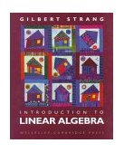

Additional Resources
18.06 Text Book
6.837 Text Book
6.837-staff@graphics.csail.mit.edu
Check the course website for a
copy of these notes
6.837 Linear Algebra Review

Slide 4

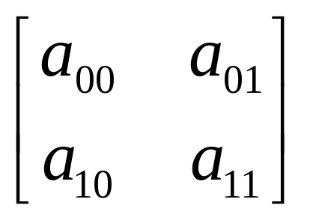
What is a Matrix?
A matrix is a set of elements, organized into rows and columns
m×n matrix
n columns
m rows
6.837 Linear Algebra Review

Slide 5
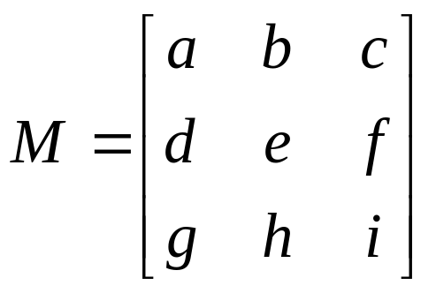
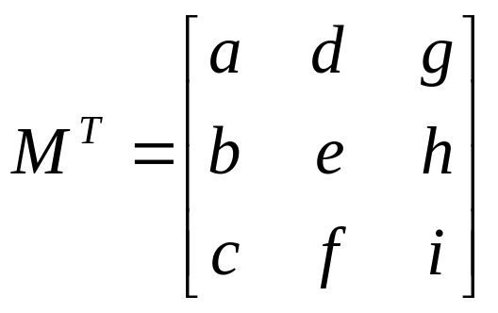
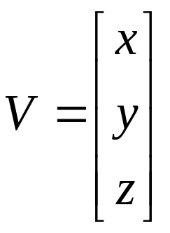
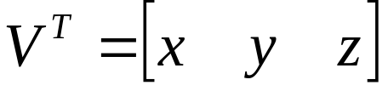
Basic Operations
Transpose: Swap rows with columns
6.837 Linear Algebra Review

Slide 6
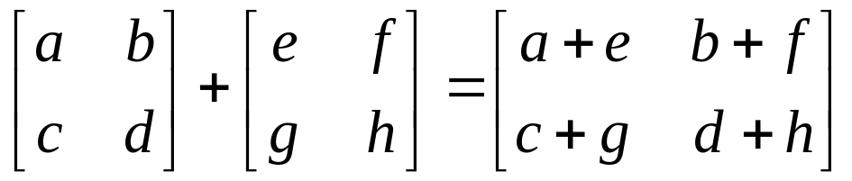
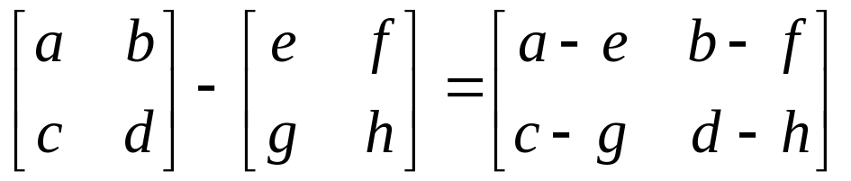
Basic Operations
Addition and Subtraction
Just add elements
Just subtract elements
A
A
A
B
B
-B
A+B
A-B
B
-B
A
A
A
6.837 Linear Algebra Review

Slide 7
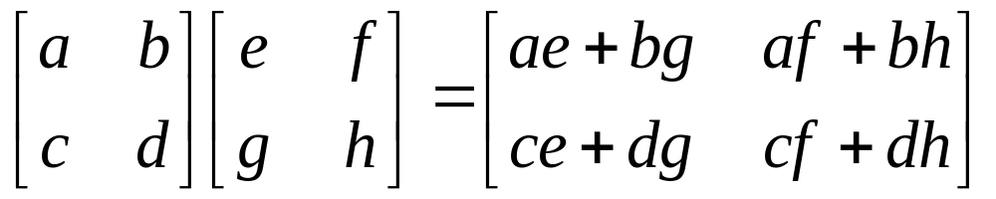
Basic Operations
Multiplication
Multiply each row by each column
An m×n can be multiplied by an n×p matrix to yield an m×p result
6.837 Linear Algebra Review

Slide 8
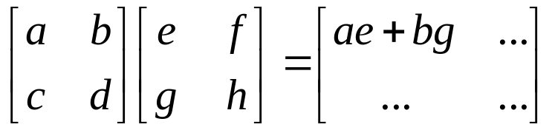
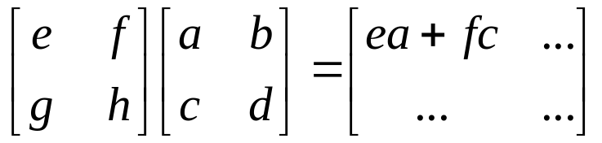
Multiplication
Is AB = BA? Maybe, but maybe not!
Heads up: multiplication is NOT commutative!
6.837 Linear Algebra Review

Slide 9
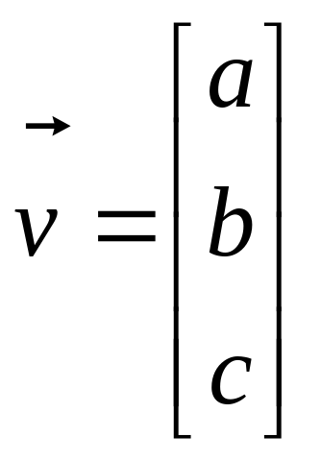
Vector Operations
Vector: n×1 matrix
Interpretation: a point or line in n-dimensional space
Dot Product, Cross Product, and Magnitude defined on vectors only
y
v
x
6.837 Linear Algebra Review

Slide 10
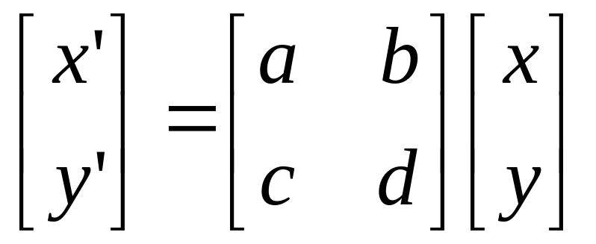
Vector Interpretation
Think of a vector as a line in 2D or 3D
Think of a matrix as a transformation on a line or set of lines
V
V’
6.837 Linear Algebra Review

Slide 11
Vectors: Dot Product
Interpretation: the dot product measures to what degree two vectors are aligned
If A and B have length 1…
A
A
B
A=B
θ
B
A·B = 0
A·B = 1
A·B = cos θ
6.837 Linear Algebra Review

Slide 12
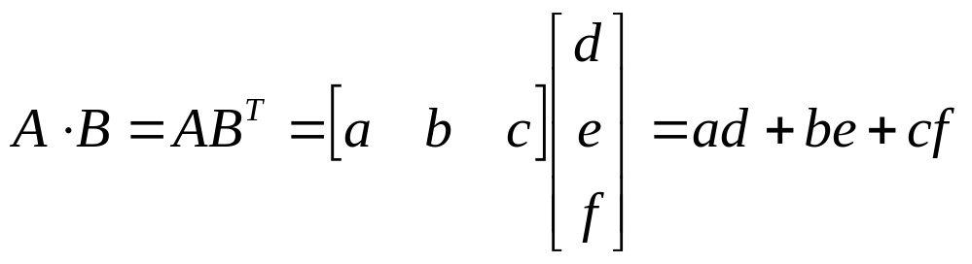
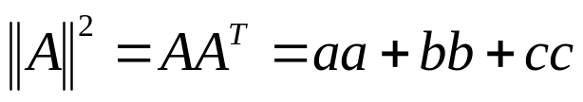

Vectors: Dot Product
Think of the dot product as a matrix multiplication
The magnitude is the dot product of a vector with itself
The dot product is also related to the angle between the two vectors
6.837 Linear Algebra Review

Slide 13
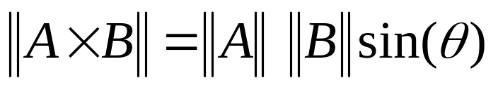
Vectors: Cross Product
The cross product of vectors A and B is a vector C which is perpendicular to A and B
The magnitude of C is proportional to the sin of the angle between A and B
The direction of C follows the right hand rule if we are working in a right-handed coordinate system
A×B
B
A
6.837 Linear Algebra Review

Slide 14
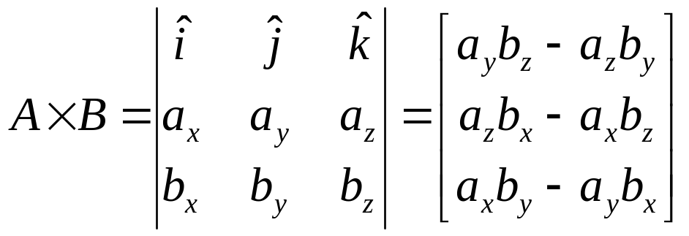
Vectors: Cross Product
The cross-product can be computed as a specially constructed determinant
A×B
A
B
6.837 Linear Algebra Review

Slide 15
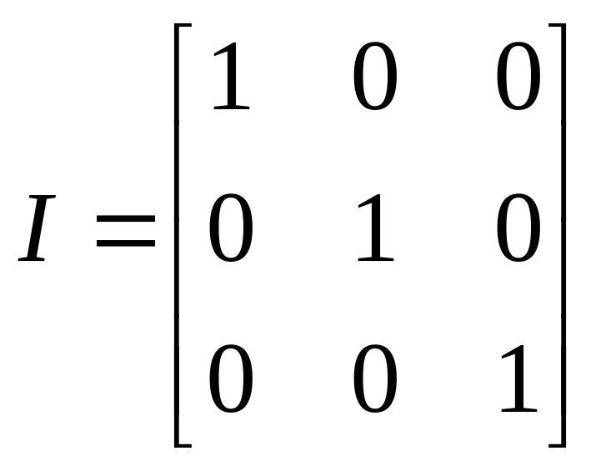
Inverse of a Matrix
Identity matrix:
AI = A
Some matrices have an inverse, such that:
AA⁻¹ = I
Inversion is tricky:
(ABC)⁻¹ = C⁻¹B⁻¹A⁻¹
Derived from non-commutativity property
6.837 Linear Algebra Review

Slide 16
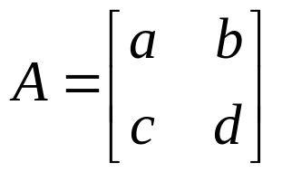

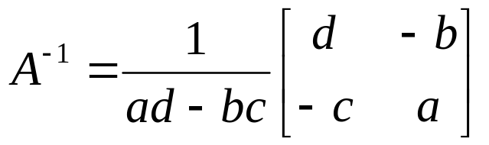
Determinant of a Matrix
Used for inversion
If det(A) = 0, then A has no inverse
Can be found using factorials, pivots, and cofactors!
Lots of interpretations – for more info, take 18.06
6.837 Linear Algebra Review

Slide 17
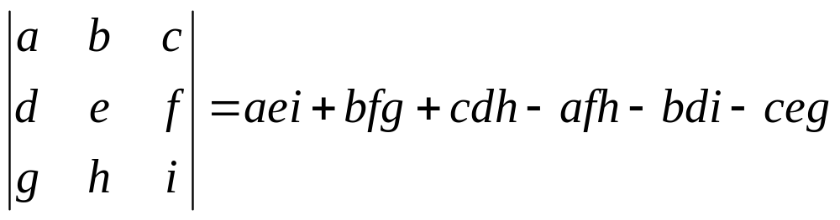
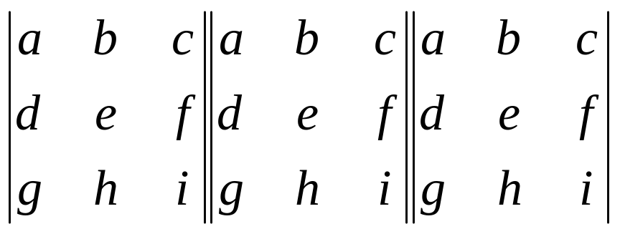
Determinant of a Matrix
For a 3×3 matrix:
Sum from left to right
Subtract from right to left
Note: In the general case, the determinant has n! terms
6.837 Linear Algebra Review

Slide 18
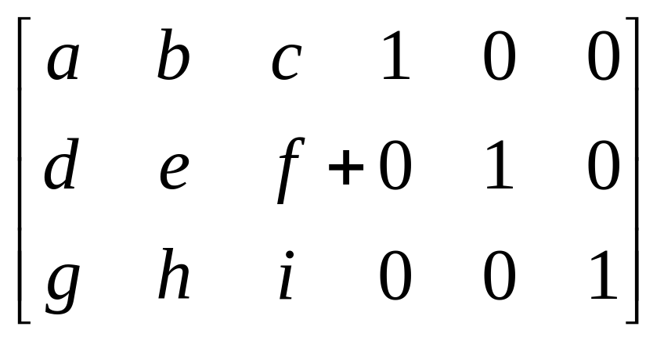
Inverse of a Matrix
Append the identity matrix to A
Subtract multiples of the other rows from the first row to reduce the diagonal element to 1
Transform the identity matrix as you go
When the original matrix is the identity, the identity has become the inverse!
6.837 Linear Algebra Review

Slide 19
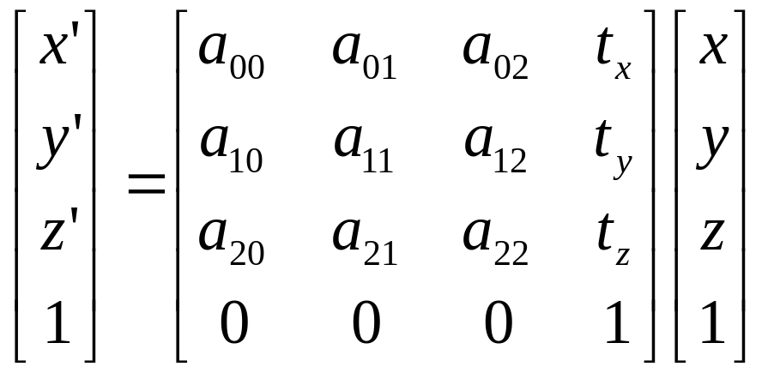
Homogeneous Matrices
Problem: how to include translations in transformations (and do perspective transforms)
Solution: add an extra dimension
6.837 Linear Algebra Review

Slide 20
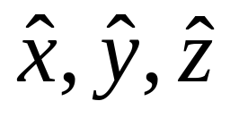
Orthonormal Basis
Basis: a space is totally defined by a set of vectors – any point is a linear combination of the basis
Orthogonal: dot product is zero
Normal: magnitude is one
Orthonormal: orthogonal + normal
Most common Example:
6.837 Linear Algebra Review

Slide 21
Change of Orthonormal Basis
Given:
  coordinate frames
  xyz and uvn
  point p = (px, py, pz)
Find:
  p = (pu, pv, pn)
v
y
p
x
v
u
u
y
x
y
v
p
u
n
x
z
6.837 Linear Algebra Review

Slide 22
Change of Orthonormal Basis
y
y
v
y . u
v
y . v
u
u
x . v
x
n
x
x . u
z
x
y
z
=
=
=
(x . u) u
(y . u) u
(z . u) u
+
+
+
(x . v) v
(y . v) v
(z . v) v
+
+
+
(x . n) n
(y . n) n
(z . n) n
6.837 Linear Algebra Review

Slide 23
Change of Orthonormal Basis
x
y
z
=
=
=
(x . u) u
(y . u) u
(z . u) u
+
+
+
(x . v) v
(y . v) v
(z . v) v
+
+
+
(x . n) n
(y . n) n
(z . n) n
Substitute into equation for p:
  p = (px, py, pz) = px x + py y + pz z
p =
px [
py [
pz [
(x . u) u
(y . u) u
(z . u) u
+
+
+
(x . v) v
(y . v) v
(z . v) v
+
+
+
(x . n) n
(y . n) n
(z . n) n
] +
] +
]
6.837 Linear Algebra Review

Slide 24
Change of Orthonormal Basis
p =
px [
py [
pz [
(x . u) u
(y . u) u
(z . u) u
+
+
+
(x . v) v
(y . v) v
(z . v) v
+
+
+
(x . n) n
(y . n) n
(z . n) n
] +
] +
]
Rewrite:
p =
[
[
[
px (x . u)
px (x . v)
px (x . n)
+
+
+
py (y . u)
py (y . v)
py (y . n)
+
+
+
pz (z . u)
pz (z . v)
pz (z . n)
] u +
] v +
] n
6.837 Linear Algebra Review

Slide 25
Change of Orthonormal Basis
p =
[
[
[
px (x . u)
px (x . v)
px (x . n)
+
+
+
py (y . u)
py (y . v)
py (y . n)
+
+
+
pz (z . u)
pz (z . v)
pz (z . n)
] u +
] v +
] n
p = (pu, pv, pn) = pu u + pv v + pn n
Expressed in uvn basis:
pu
pv
pn
=
=
=
px (x . u)
px (x . v)
px (x . n)
+
+
+
py (y . u)
py (y . v)
py (y . n)
+
+
+
pz (z . u)
pz (z . v)
pz (z . n)
6.837 Linear Algebra Review

Slide 26
Change of Orthonormal Basis
pu
pv
pn
=
=
=
px (x . u)
px (x . v)
px (x . n)
+
+
+
py (y . u)
py (y . v)
py (y . n)
+
+
+
pz (z . u)
pz (z . v)
pz (z . n)
  In matrix form:
where:
pu
pv
pn
ux
vx
nx
uy
vy
ny
uz
vz
nz
px
py
pz
ux = x . u
=
uy = y . u
etc.
6.837 Linear Algebra Review

Slide 27
Change of Orthonormal Basis
pu
pv
pn
ux
vx
nx
uy
vy
ny
uz
vz
nz
px
py
pz
px
py
pz
=
= M
  What's M⁻¹, the inverse?
px
py
pz
xu
yu
zu
xv
yv
zv
xn
yn
zn
pu
pv
pn
ux = x . u = u . x = xu
=
M⁻¹ = M^{T}
6.837 Linear Algebra Review

Slide 28
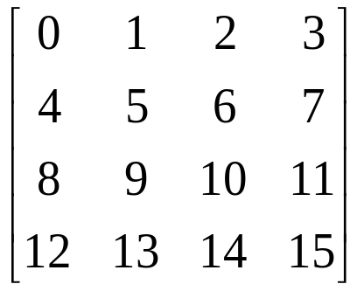
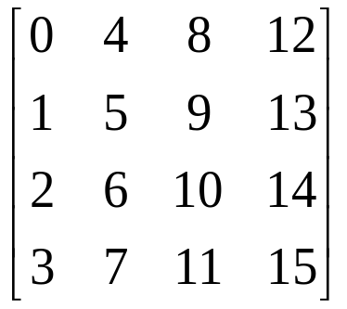
Caveats
Right-handed vs. left-handed coordinate systems
  OpenGL is right-handed
Row-major vs. column-major matrix storage.
  matrix.h uses row-major order
  OpenGL uses column-major order
row-major
column-major
6.837 Linear Algebra Review

Slide 29
Questions?
?
6.837 Linear Algebra Review

